Slide 1
NAPEO First Friday Webinar
Small and Resilient
Prioritizing workforce well-being in a challenging economic environment
Material discussed is meant for general illustration and/or informational purposes only and it is not to be construed as tax, legal, financial, investment or medical advice. Although the information has been gathered from sources believed reliable, please note that individual situations can vary, therefore the information should be relied upon when coordinated with individual professional advice.
This seminar is for informational purposes only. The guest speaker appearing at this seminar is solely responsible for the content of their presentation, which may not necessarily represent the opinions of Guardian or its affiliates and subsidiaries. Although the information has been gathered from sources believed to be reliable, please note that individual situations can vary.
Guardian, its subsidiaries, agents, and employees do not provide tax, legal, financial, investment or medical advice. Consult your tax, legal, financial, investment or medical professional regarding your individual situation. GUARDIAN® is a registered service mark of The Guardian Life Insurance Company of America 2023® The Guardian Life Insurance Company of America, New York, N.Y. 2023-150719 (1/25)

Slide 2
Today’s Speakers
Angela St. Paul
PEO Channel Development Leader
Dan McHenry
Business Advisory Group Practice Leader
Stephanie Kacoyanis
Group Benefits Thought Leadership Content Lead

Slide 3
Today’s topics
1
The Current Economic Climate: How Did We Get Here?
2
Talent Attraction and Retention
3
Benefits That Promote Worker Well-being
4
Considerations for Growth
5
Q&A
Notes:
Thanks so much for that introduction, great to be here. On this slide is an overview of what we’ll be covering today: we’ll start with a look at the current economic climate, talk about some small business challenges including talent attraction and retention, look at some of the benefits trends we’re seeing in small businesses, and talk about some ways small businesses are growing and looking toward the future. Finally, as always, we’ll end with a Q&A.

Slide 4
Today’s session qualifies for one professional development credit with SHRM and HRCI
Important:
We will provide you with the SHRM and HRCI codes at the end of today’s session.
Notes:
And finally, today’s webinar is eligible for one professional development credit from the Society of Human Resources Management or the Human Resources Certification Institute. The codes you’ll need to receive credit will be displayed at the end of today’s webinar, so please stay tuned and take note of those when we display them.

Slide 5
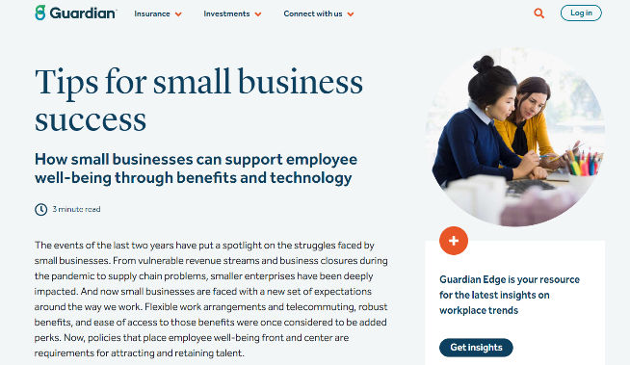
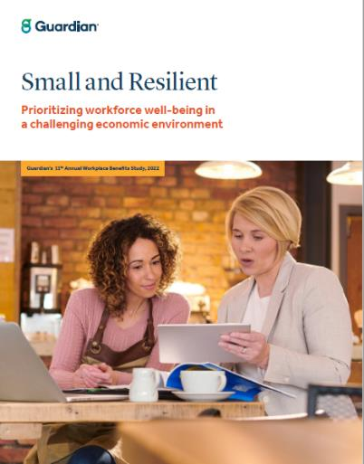
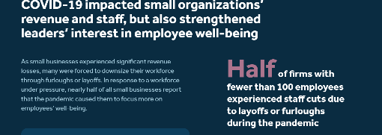
“Small and Resilient” Report and Resources
On guardianlife.com
Access additional
information via links in the chat!
Notes:
I did want to mention that the majority of the data you’ll se today in our slides is from a recent Guardian thought leadership report, Small and Resilient, so same name as our webinar. You can check it out; the link will be made available to you via the chat at some point.

Slide 6
The Current Economic Climate: How Did We Get Here?
Notes:
As I mentioned earlier, there have been a number of factors impacting our current economic state and how that creates challenges for small businesses. So I’d like to kick things off with our first polling question and ask you, If you’re a small business owner or a PEO working w/ small business clients, what are your top challenges? (Talent attraction/retention; revenue/growth; supply chain issues; offering a competitive benefits package; compliance issues; economic conditions)

Slide 7
Economic uncertainty forces small businesses to prepare for a possible recession
Small businesses face compounding challenges
The pandemic caused an additional 200,000 permanent closures of business over pre-pandemic levels¹
1 in 10 organizations with 50-99 workers say they’ve experienced a moderate or significant decline in revenue during the past 3 years²
Sources: 1: Business Insider 2021. 2: Guardian’s 11th Annual Workplace Benefits Study
Notes:
So we’re seeing revenue issues, definitely talent attraction and retention. We’ll get to that in a moment. So as we can see on the slide, lost revenue is causing many businesses to close. For the businesses that are still operating…
How do see these economic challenges playing out for your WORKSITES clients? (Dan – Great Resignation, employee’s market)
What’s on SBOs’ minds now that wasn’t before? (Implications of lifting COVID laws, pressures around running a business, Desiree)
What other pressures do you see on small businesses (Dan - Minimum wage laws, SOFIA: remote work/compliance question

Slide 8
Talent Attraction and Retention
Notes:
Polling Question: How much do you think it costs to replace a worker (1/2 their annual salary; 1x their annual salary; 1.5x annual salary; 2x their annual salary)

Slide 9
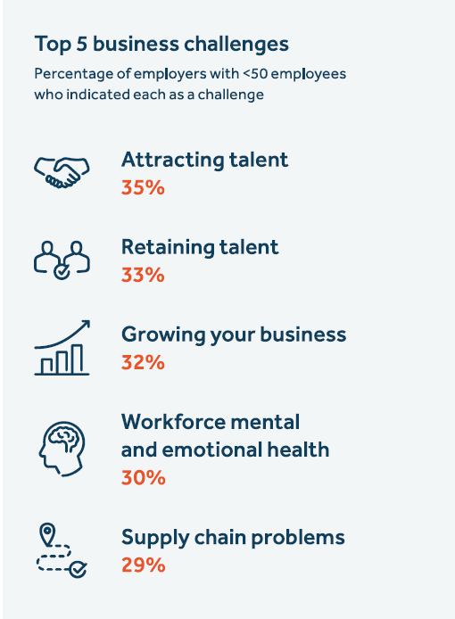
Employee turnover could cripple small businesses
90% of small businesses hiring are finding it difficult to recruit qualified candidates¹
4
Nearly 60% of small companies report worker shortages are affecting their ability to operate at full capacity.²
The cost of replacing a worker can range from one-half to two times the employee’s annual salary.³
1: Associated Press, 2022. 2 & 4: Guardian’s 11th Annual Workplace Benefits Study. 3: Gallup 2019.
Notes:
WE see this often, many of the small businesses I personally frequent have reduced hours, closed more days to cope with this. Even though the Great Resignation is over, it sometimes doesn’t feel like it.
There was a time when many workers wanted to work at small businesses because they wanted to be in a more close-knit environment, feel they were closely contributing to an org’s mission, etc. What’s changed? Is it all about salary? DAN

Slide 10
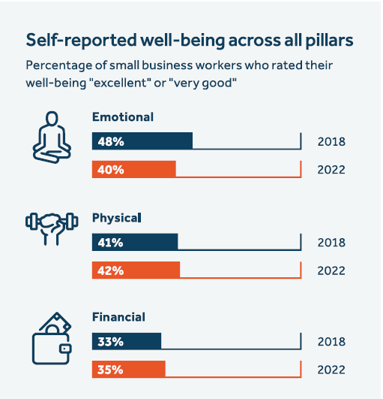
Workers at small firms have lower overall well-being
37% of workers at small businesses report low overall well-being
48% of workers at small businesses say money/finances is the greatest source of stress in their life.
30% of small business workers earn les than $50,000 annually.
All sources on slide: Guardian’s 11th Annual Workplace Benefits Study.
Notes:
How are small employers addressing talent attraction and retention issues from a benefits perspective? ANGIE

Slide 11
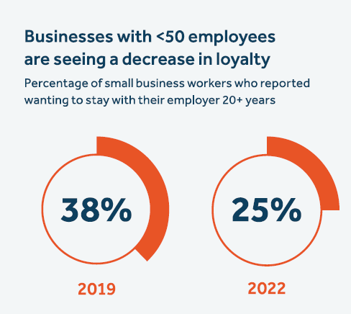
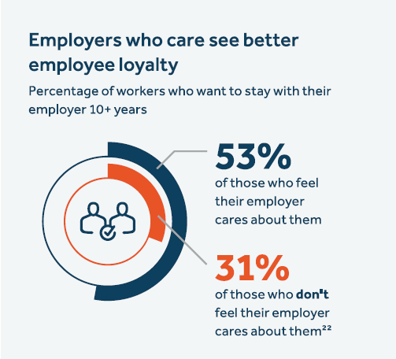
Lower overall well-being impacts loyalty
37% of workers at small businesses report low overall well-being
All sources on slide: Guardian’s 11th Annual Workplace Benefits Study.
Notes:
But one reason behind this is that, overall, small business workers have lower overall well-being than workers at larger companies. 45% say they live paycheck to paycheck. And there’s been a significant decrease in loyalty. There was a time when many workers wanted to work at small businesses because they wanted to be in a more close-knit environment, feel they were closely contributing to an org’s mission, etc. What’s changed? Is it all about salary? (Angie)
How are small employers addressing talent attraction and retention issues from a benefits perspective? (Angie incl. financial benefits, creative solutions re retirement)

Slide 12
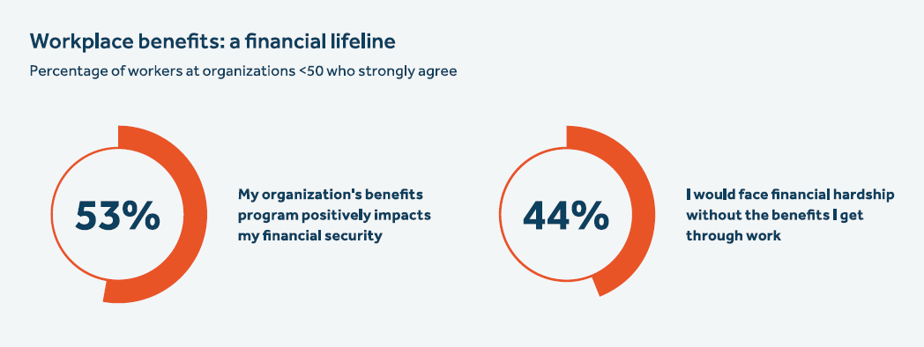
Small business workers’ lower understanding of their benefits is partly to blame for their lower financial confidence
33% of small business workers rate their benefits knowledge “low” compared to just 19% of workers at larger organizations
56% of workers at firms with 50-99 employees wish their employer would provide decision support tools to help them select their benefits.
All sources on slide: Guardian’s 11th Annual Workplace Benefits Study.
Notes:
What, in your opinion, is the most effective (from a process perspective) you’ve seen SBOs implement to attract and retain quality talent? (Dan)
How can small businesses better educate and promote benefits to their workers? (Angie)

Slide 13
Benefits That Promote Worker Well-being
Notes:
Question 3 (before slide 13): What types of benefits have you seen small businesses add that get the most utilization? (type into chat)

Slide 14
Small businesses are investing more in benefits offerings
Benefits Growth at Small Firms³
Percentage of small employers offering each benefit
7 in 10 small firms say they aim to offer a better benefits package than their industry competitors
However, small firms lag in dental offerings:
Nearly 6 in 10 employees at small businesses lack dental insurance through work.¹
Among working Americans who are least likely to go to the dentist, 65% work for small businesses.²
1 & 2: Guardian’s Dental Fundamentals Report, 2022. 3: Guardian’s 11th Annual Workplace Benefits Study.
Notes:
We’re seeing overall positive trends when it comes to small businesses and benefits. Motivated in part by the talent attraction/retention issues they’re facing, 7 in 10 now say they aim to offer a better benefits package than their competitors. The bar chart on the right bears this out.
Why is the invest in benefits so critical to a small business bottom line. DAN
When small business owners want to re-evaluate benefits strategy, how do you advise they begin? ANGIE
How can you ensure you’re offering benefits your worksite will actually want and use? ANGIE

Slide 15
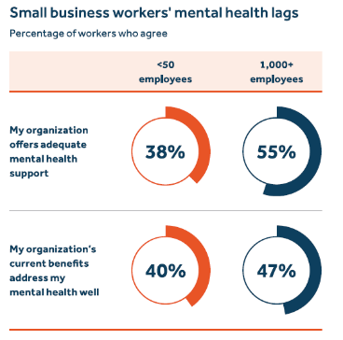
Small businesses are investing in mental health benefits…
…but gaps remain
61% of small employers agree their organizations should do more to improve workers’ mental health, up 16% from 2021
More than a quarter of workers at small businesses experienced anxiety, depression, or another mental health issue in the past year
Benefit | <50 workers | 50-99 workers
Flex work schedules | 43% | 40%
Paid sick/personal leave | 38% | 50%
Mental health resources via medical insurance plan | 35% | 44%
Onsite behavioral health counselors | 31% | 29%
Employee support groups | 29% | 31%
Behavioral health programs separate from EAP | 26% | 32%
Employee Assistance Program (EAP) | 22% | 28%
Guardian’s 11th Annual Workplace Benefits Study.
Notes:
What types of mental health benefits have you seen small businesses implement that get utilization? (Angie)

Slide 16
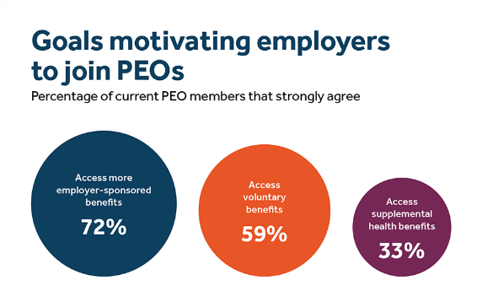
Greater benefits offerings often drive PEO partnerships
Most employers who partner with PEOs do so to offer a greater variety of employee benefits
Source: Guardian’s 11th Annual Workplace Benefits Study

Slide 17
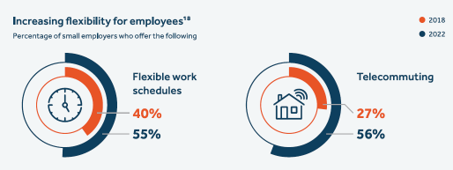
Small employers expand telecommuting and flexible work
One third of small business workers say they’ve left their job because of inflexible hours and the inability to work remotely
Top factors determining where employees choose to work:
1 Compensation
2 Benefits
3 Flexibility
Source: Guardian’s 11th Annual Workplace Benefits Study
Notes:
There’s a correlation between working remotely and better mental health. 49% of those whose orgs allow remote work rate themselves highly at taking care of their mental health compared to just 38% of those whose orgs don’t allow it. SO this is another area where should be promoting flexible policies.

Slide 18
How PEO use positively impacts employee well-being
Employers using PEOs are more likely to have adapted their benefits and policies to what workers need
70% of businesses using a PEO say they provide support for employees with caregiving responsibilities versus 53% of those that don’t use a PEO.
Nearly 8 in 10 employers using a PEO agree they have a responsibility to ensure the financial preparedness of their workers compared to just 7 in 10 that don’t use a PEO.
Source: Guardian’s 11th Annual Workplace Benefits Study

Slide 19
Considerations for Growth
Notes:
So finally, what are some of the things that can help with growth?

Slide 20
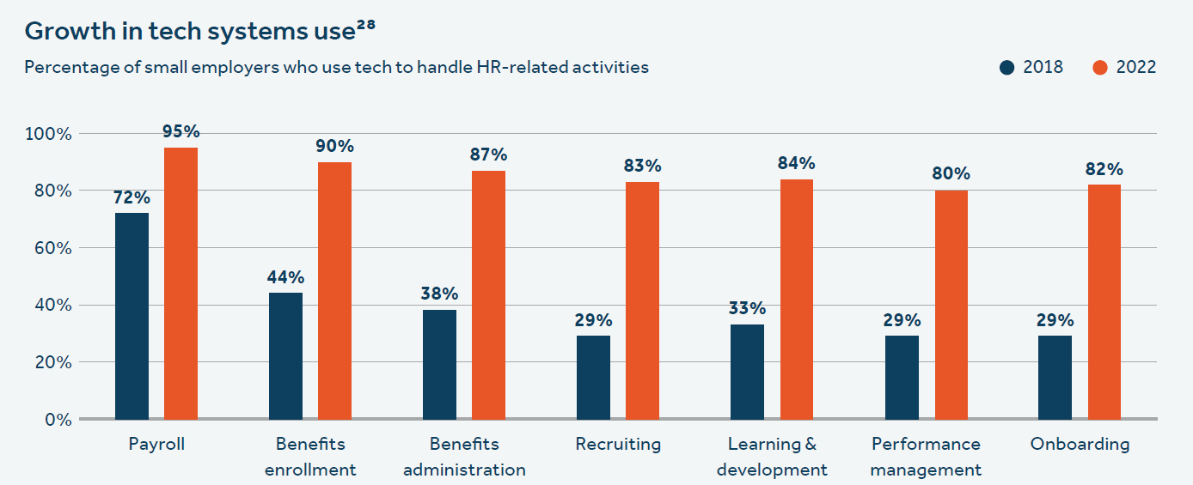
Small firms are bullish when it comes to tech investments
82% of small firms say they plan to increase spending on HR tech in the next 3 years
Source: Guardian’s 11th Annual Workplace Benefits Study
Notes:
How can small businesses evaluate and/or develop more sophisticated tech strategies? ANGIE
How should small businesses think about PEO and how has the industry grown. DAN

Slide 21
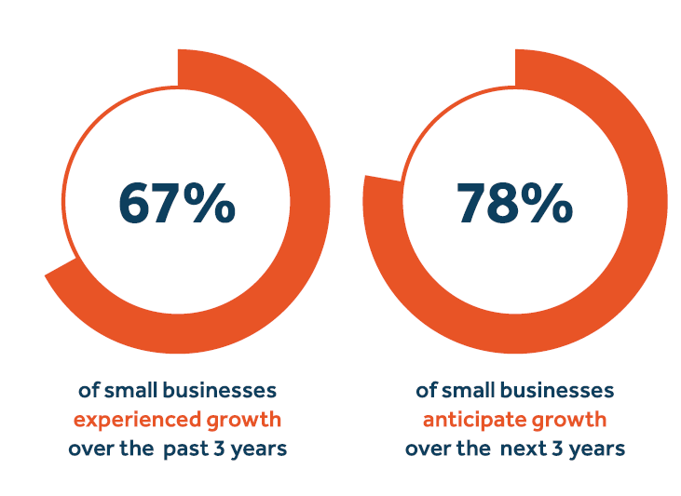
Despite an uncertain economic climate, most small firms are growing and anticipate further growth
Approximately two-thirds of small businesses experienced moderate to significant growth in the past year
A rosy outlook
Percentage of small businesses expecting significant growth in the next 3 years
48%
29%
Tech firms
Professional/
financial services
54%
11%
<5 years in business
30+ years in business
44%
15%
Highly digital benefits admin
Paper-based benefits admin
Source: Guardian’s 11th Annual Workplace Benefits Study
Notes:
What are some cost-effective ways small businesses can offer a wider variety of benefits? (ANGIE)
How is the current climate contributing to a moment of opportunity for PEOs? (DAN)

Slide 22
Questions?
Notes:
What do small businesses that are thriving in this difficult economic climate have in common? (Desiree – always being innovative and constantly reviewing what they can do to improve; Carrie – benefits-related, Sofia – clear, consistent expectations and communicate well, understand capacity well, tightening up job descriptions)
We are a very small organization with fewer than 10 employees. What are some low-cost ways to support employee well-being? (Carrie)
What’s one of the biggest mistakes you see small businesses make when it comes to communication with their planning? (“The power team” – administration, execution, not on the same page. Making sure you team is cohesive) Desiree
Tech change/growth happening at a breakneck pace. How do you adapt and find the time to find the right solution? (Sofia, Carrie)
What do you think small business owners maybe aren’t considering or asking you about regarding the future that they should be? (Desiree, Carrie, Sofia)

Slide 23
Obtaining your SHRM and HRCI credits
Small and Resilient
Value: 1 PDC
SHRM activity ID: 24-7DF2R
Log onto portal.shrm.org
561282
HRCI activity ID: 620450
Log onto hrci.org

Slide 24
Contact info
Angela St. Paul
PEO Channel Development Leader
Email: angela_stpaul@glic.com
Dan McHenry
Business Advisory Group Practice Leader
Email: dan@mchenryconsulting.net
Stephanie Kacoyanis
Group Benefits Thought Leadership Content Lead
Email: stephanie_Kacoyanis@glic.com

Slide 25
Thank you
Material discussed is meant for general illustration and/or informational purposes only and it is not to be construed as tax, legal, financial, investment or medical advice. Although the information has been gathered from sources believed reliable, please note that individual situations can vary, therefore the information should be relied upon when coordinated with individual professional advice. This seminar is for informational purposes only. The guest speaker appearing at this seminar is solely responsible for the content of their presentation, which may not necessarily represent the opinions of Guardian. Although the information has been gathered from sources believed to be reliable, please note that individual situations can vary. Guardian, its subsidiaries, agents, and employees do not provide tax, legal, or accounting advice. Consult your tax, legal, financial, investment or medical professional regarding your individual situation. GUARDIAN® is a registered service mark of The Guardian Life Insurance Company of America 2023® The Guardian Life Insurance Company of America, New York, N.Y. 2023-150719 (1/25)

